Slide 1


Help Desk Application
Project by
James Silcott

Slide 2
Project Tasks
Create to run on Windows 10 and mobile
Design Login Screen
Design Register Page
Design the User Interface for Customer-Users
Design the User Interface for Admin-Users
Design Ticket Selection Database
Design Admin Manager Page
Design Security Page
Design System Files
Design System Logs
Design About Page
Design Help Page

Slide 3
Log In Screen & Register Page Design
Create text boxes that allow user input for:
“Roles” Dropdown select choosing:
Admin for developer-user
User – for customers
Username
Password
Register Button
Takes you to another screen that has text boxes for the following:
Username (system check to see if it not already in use and is longer than 4 characters)
Email address (after submittal of this register, an email will be sent)
Phone Number (sends a SMS text with username if “forgot username” is used
Password
Must have at least one non letter or digit character
Must have at least one digit (‘0’-’9’)
Must have at least one uppercase (‘A’-’Z’)
Enter Password Again
Create account button
Stores username, email, phone number and assign a to a ID number to a table
Have forgot username and/or password button
Button takes you to another screen asking for more personal info
Asks what you forgot
Username Button, this asks for your phone number and sends you a SMS text
Password Button, this asks for your username and email address then email it
Behind-the-scenes
Every log in will track the time and date, storing the info into a database with the username and is accessible by the Admin Page

Slide 4
Log-in Screen
Register
Log In
Username
Password
Role:
Admin
User
Forgot Username
Forgot Password
Forgot Username Screen
What is?
Phone Number
Forgot Password Screen
What is?
Username
Email Address

Slide 5
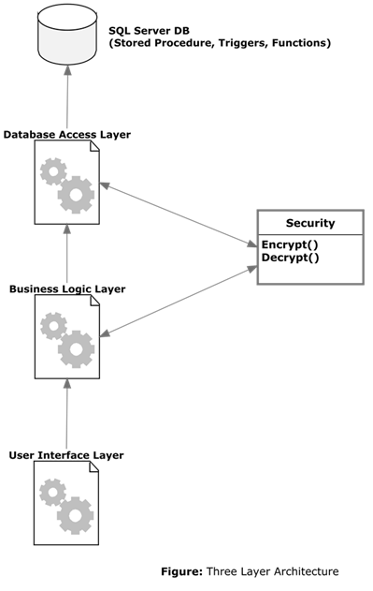
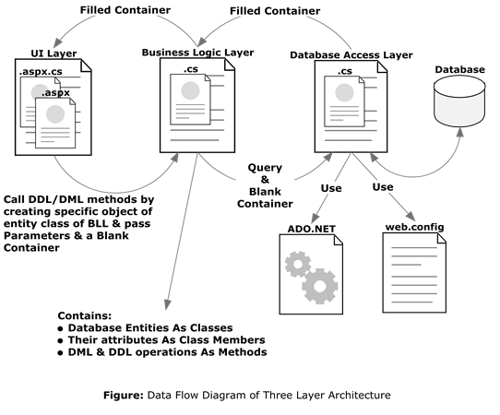
3 Layer Architecture C# .NET
https://www.codeproject.com/Articles/679185/Understanding-Three-Layer-Architecture-and-its

Slide 6
Register Screen
Username
Password
Enter Password Again
Email
Phone
Role:
Admin
User

Slide 7
User Interface Customers & Admin Design
Log In Screen
Customer-user Home Page
Create Ticket Selection
Update Ticket Selection
Any updates will show:
Updated date:
Updated by:
Delete Ticket Selection
Log Off
Developer-user Home Page
Has all the functions a Customer-user has
Includes an “Administration” dropdown that includes the following:
Admin Mangers
Take you to the page showing a list of Admins and the last log in time/date
Application Settings
Unknown
Security
Takes you to the security page
System Files
Takes you to a page with any attachments and files
User & System logs
Takes you to a page showing all users and their tickets and info
Shows any System issues
Has searchable and filter functions of all ticket info and users
Search Screen

Slide 8
User Screen
Menu
Log off
Home
Existing Tickets
Reports
Edit Profile
Create Ticket
Update Ticket
Delete Ticket
Admin Screen
Menu
Admin
Log off
Home
Existing Tickets
Reports
Edit Profile
Admin Managers
Application Settings
Security
System Files
User & System Logs
Create Ticket
Update Ticket
Delete Ticket

Slide 9
Ticket Selection Design & Database
Ticket Visible-to-Users Tasks
Status
Requester Name
Phone
Assigned Group/Unit/Work Center
Comments
Priority Level
Low
Normal
High
Due Date
Date Entered
Start Date
Complete Date
Estimated Hours
Estimated Costs
Attachments such as pictures and documents (word, excel, pdf)
Email
This will email the user a notification showing their ticket info and keept hem updated on the status
Ticket Behind-the-Scene Tasks
Create ID number to file
Store all data inputted form users
Allow data to be searchable by any values and table columns

Slide 10
Create & Edit Ticket Screen
Menu
Log off
Ticket Number
Date Entered
Requester Name
Entered Automatically
Entered Automatically
Assigned Group
Compl Date
Comments
Est Hours
Entered Automatically
Phone
Est Costs
Priority Level
Email
Entered Automatically
Due Date
Attachments
Ticket Update & Delete Screen
Menu
Log off
Update
Delete
Ticket ID | Requester Name | Group | Priority | Phone

Slide 11
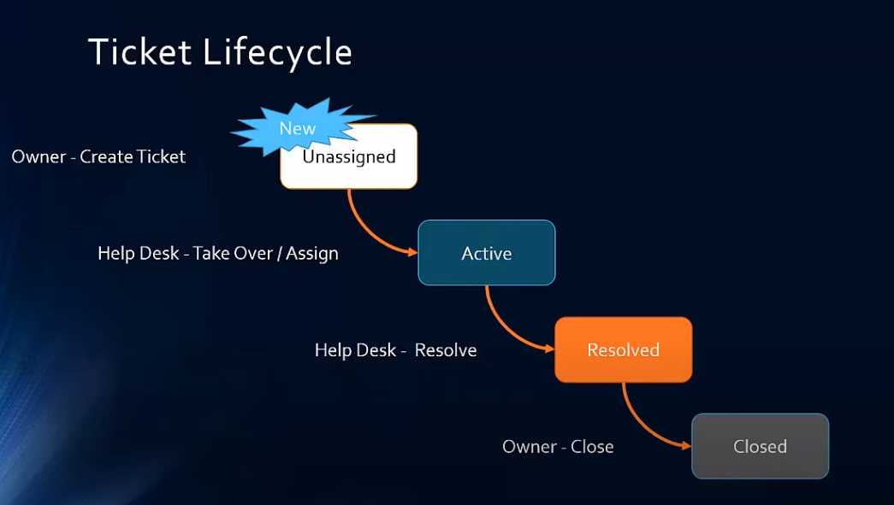
User & System Logs
Home
Existing Tickets
Reports
Administration

Slide 12
Admin Page
Home
Existing Tickets
Reports
Administration
Application Settings
Unknown
Security
Takes you to the security page
System Files
Takes you to a page with any attachments and files
User & System logs
Takes you to a page showing all users and their tickets and info
Shows any System issues
Has searchable and filter functions of all ticket info and users

Slide 13
Admin Page
Home
Existing Tickets
Shows by statuses:
Active
Inactive
Complete
Reports
Administration
Application Settings
Unknown
Security
Takes you to the security page
System Files
Takes you to a page with any attachments and files
User & System logs
Takes you to a page showing all users and their tickets and info
Shows any System issues
Has searchable and filter functions of all ticket info and users

